Slide 1
Celebrate.NCcourts.org
Notes:
A speaker will want to add date, organization being spoken to and identifying information to this slide.

Slide 2
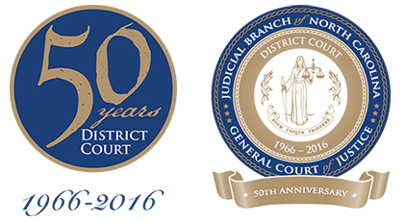
District Court Milestone Anniversary
District Court

Slide 3
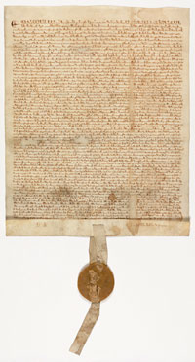
Magna Carta
(39) No free man shall be seized or imprisoned, or stripped of his rights or possessions, or outlawed or exiled, or deprived of his standing in any way, nor will we proceed with force against him, or send others to do so, except by the lawful judgment of his equals or by the law of the land.
+ (40) To no one will we sell, to no one deny or delay right or justice.
Notes:
This slide is included to connect the North Carolina Courts in general and the district court in particular to the common law tradition that has been the foundation of the American Court system. These provisions of the Magna Carta, the document that is often cited as the beginning of the English legal system, are similar to provisions that are still in the North Carolina Constitution. They are the basis of the concept of due process and more basically of the notion that courts primary mission is to do justice in a fair manner.

Slide 4
All courts shall be open
…
and the right and justice shall be administered without favor, denial or delay
North Carolina Constitution, Section 18

Slide 5
North Carolina Constitution—Declaration of Rights, Article 1
Sec. 18. Court shall be open.
  All courts shall be open; every person for an injury done him in his lands, goods, person, or reputation shall have remedy by due course of law; and right and justice shall be administered without favor, denial, or delay.
Sec. 19. Law of the land; equal protection of the laws.
  No person shall be taken, imprisoned, or disseized of his freehold, liberties, or privileges, or outlawed, or exiled, or in any manner deprived of his life, liberty, or property, but by the law of the land.
  No person shall be denied the equal protection of the laws; nor shall any person be subjected to discrimination by the State because of race, color, religion, or national origin.
Notes:
These provisions, from the Declaration of Rights in the NC Constitution, are easily traced to the Magna Carta, and have been in all NC constitutions in some form since 1776. The district court is new to some extent, but it’s basic function has been in place for a long time. Standing on the shoulders of many great judges and lawyers, the District Court is part of a rich heritage of seeking justice for its citizens.

Slide 6
History Of Court Reform
District courts replaced a patchwork system of local courts.
  More than 250 in North Carolina
Local courts were not uniform in any way
  Subject matter jurisdiction
  Costs
  Procedural rules
  Method of selection
  Pay of judges
Notes:
This slide should provide an opportunity to talk about the reason the district court came into being. The patchwork, which would be different in every district, so it cannot be detailed in a slide like this, came about because two things happened.. The first was a provision put in the state constitution in 1875 that allowed local units of government to establish courts below the superior court. The second was the rapid growth and industrialization of the state, particularly in the latter part of the 19th century and the 20th century. As a result, the power to establish local courts was exercised freely, with many variations as each locality responded to their needs differently. The resulting patchwork, with the differences noted above became difficult to navigate for outsiders, and often resulted in cases being filed in the “wrong” court. It was very confusing, and to a state that wanted a strong commercial stream, the desire for uniformity was strong in the 1950’s.

Slide 7
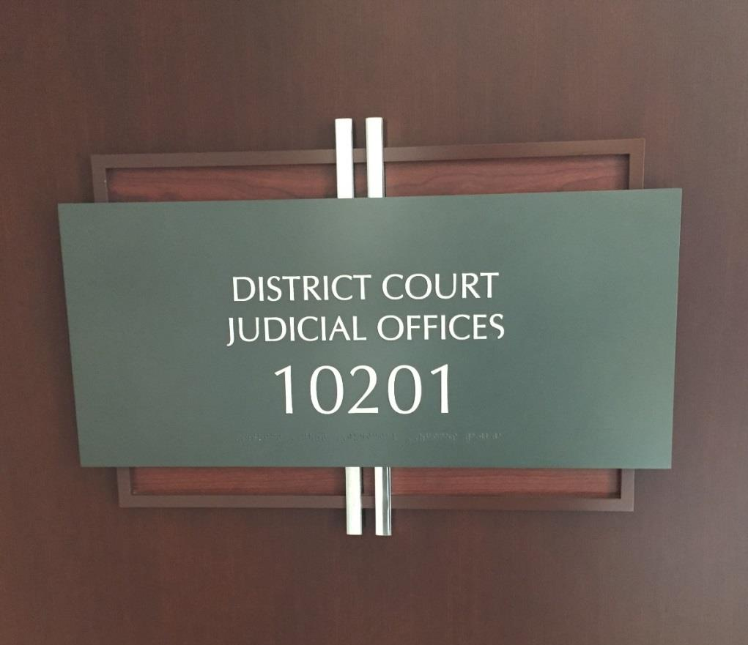
Features of District Court
Uniform jurisdiction
Uniform method of selection and compensation
Operating costs paid by state
Notes:
This slide highlights the fundamental differences between the patchwork of local courts and the new district court. Court reform eliminated all local courts below the superior court and in their place created the district court and it replaced the office of justice of the peace with the magistrate. It may be worth noting here that in the modern courts, no official’s compensation is determined by the fees he or she collects; everyone is paid a salary from the state. The Superior Court and the office of the Clerk of Court predate court reform, although in both cases their jurisdiction was altered. The clerks assumed all the duties of the clerks for the various local courts and they retained the powers associated with being a probate judge.

Slide 8
Officials in the Courthouse
Superior court judges
  Senior resident superior court judge
District court judges
  Chief district court judge
Clerk of superior court
  Assistant and deputy clerks
Magistrate
District attorney
  Assistant district attorney
Public defender
  Assistant public defender
Notes:
For those who think it is useful to describe the various actors in the courthouse, this list can serve as a guide to structure the discussion. The roles should be obvious to anyone giving a talk on this subject. One might mention the various administrative support staff positions such as trial court administrator, trial court coordinator, judicial assistant, family court administrator, GAL administrator, custody mediators, etc. They are invaluable colleagues in the operation of the district court.

Slide 9
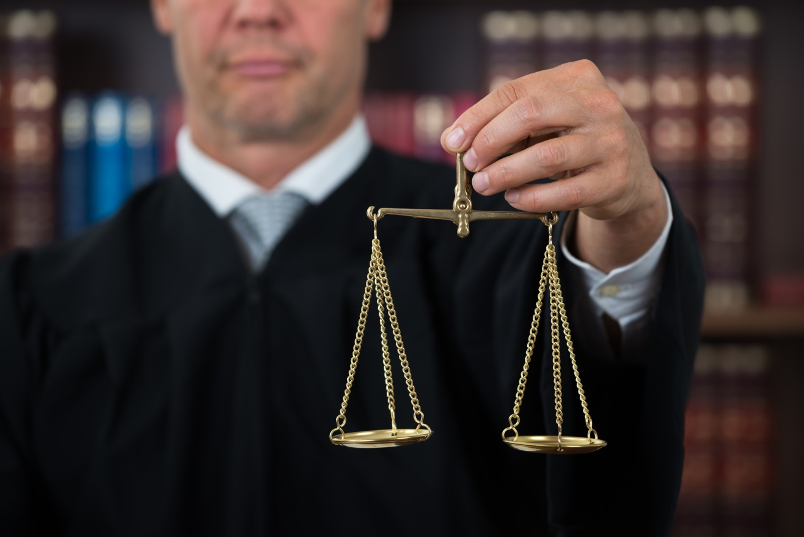
District Court is an Elected Office
District elections
Four-year terms
Nonpartisan
All elections are for designated seats
There are no specialized seats; all judges
can do all tasks assigned to the court
This district consists of xxxx county(ies)
Notes:
This slide provides a chance to explain the electoral system for the district court. It may be helpful to contrast the particulars of the district court with the elections for other court officials. DA’s and clerks are partisan, clerks only run in a single county, Superior Court are not designated seats and run for 8 years, often in smaller districts.
Not included here, but it could be added, is any mention of the salary. It should mention that there are different salaries for chief judges and that longevity can increase the salary over time.

Slide 10
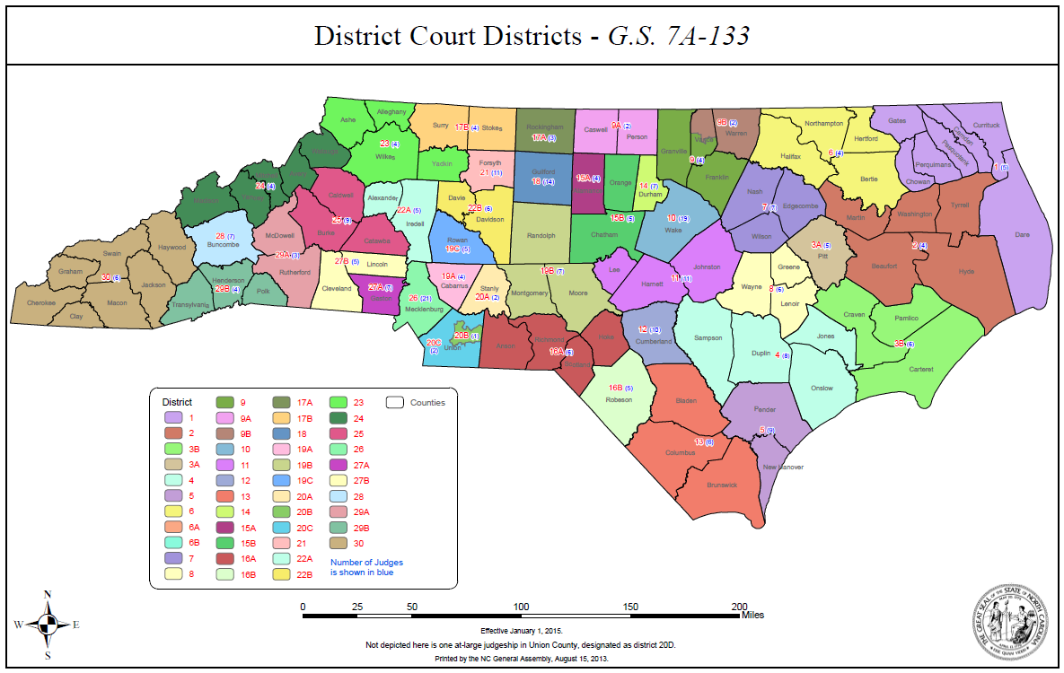
District xxxxxx
In 1970, when the District Court was operational in all counties, there were 112 judges
Today there are judge positions authorized.
In District, there were judges when the district court was established here.
Today there are judge positions authorized for this district.
Notes:
This slide offers the opportunity to create a slide for a particular district that provides a snapshot into the growth of the district court in the district. It can be supplemented with population growth pretty easily by going to websites like the us census bureau or the State Budget Office website on state demographics at http://www.osbm.nc.gov/facts-figures/demographics.

Slide 11
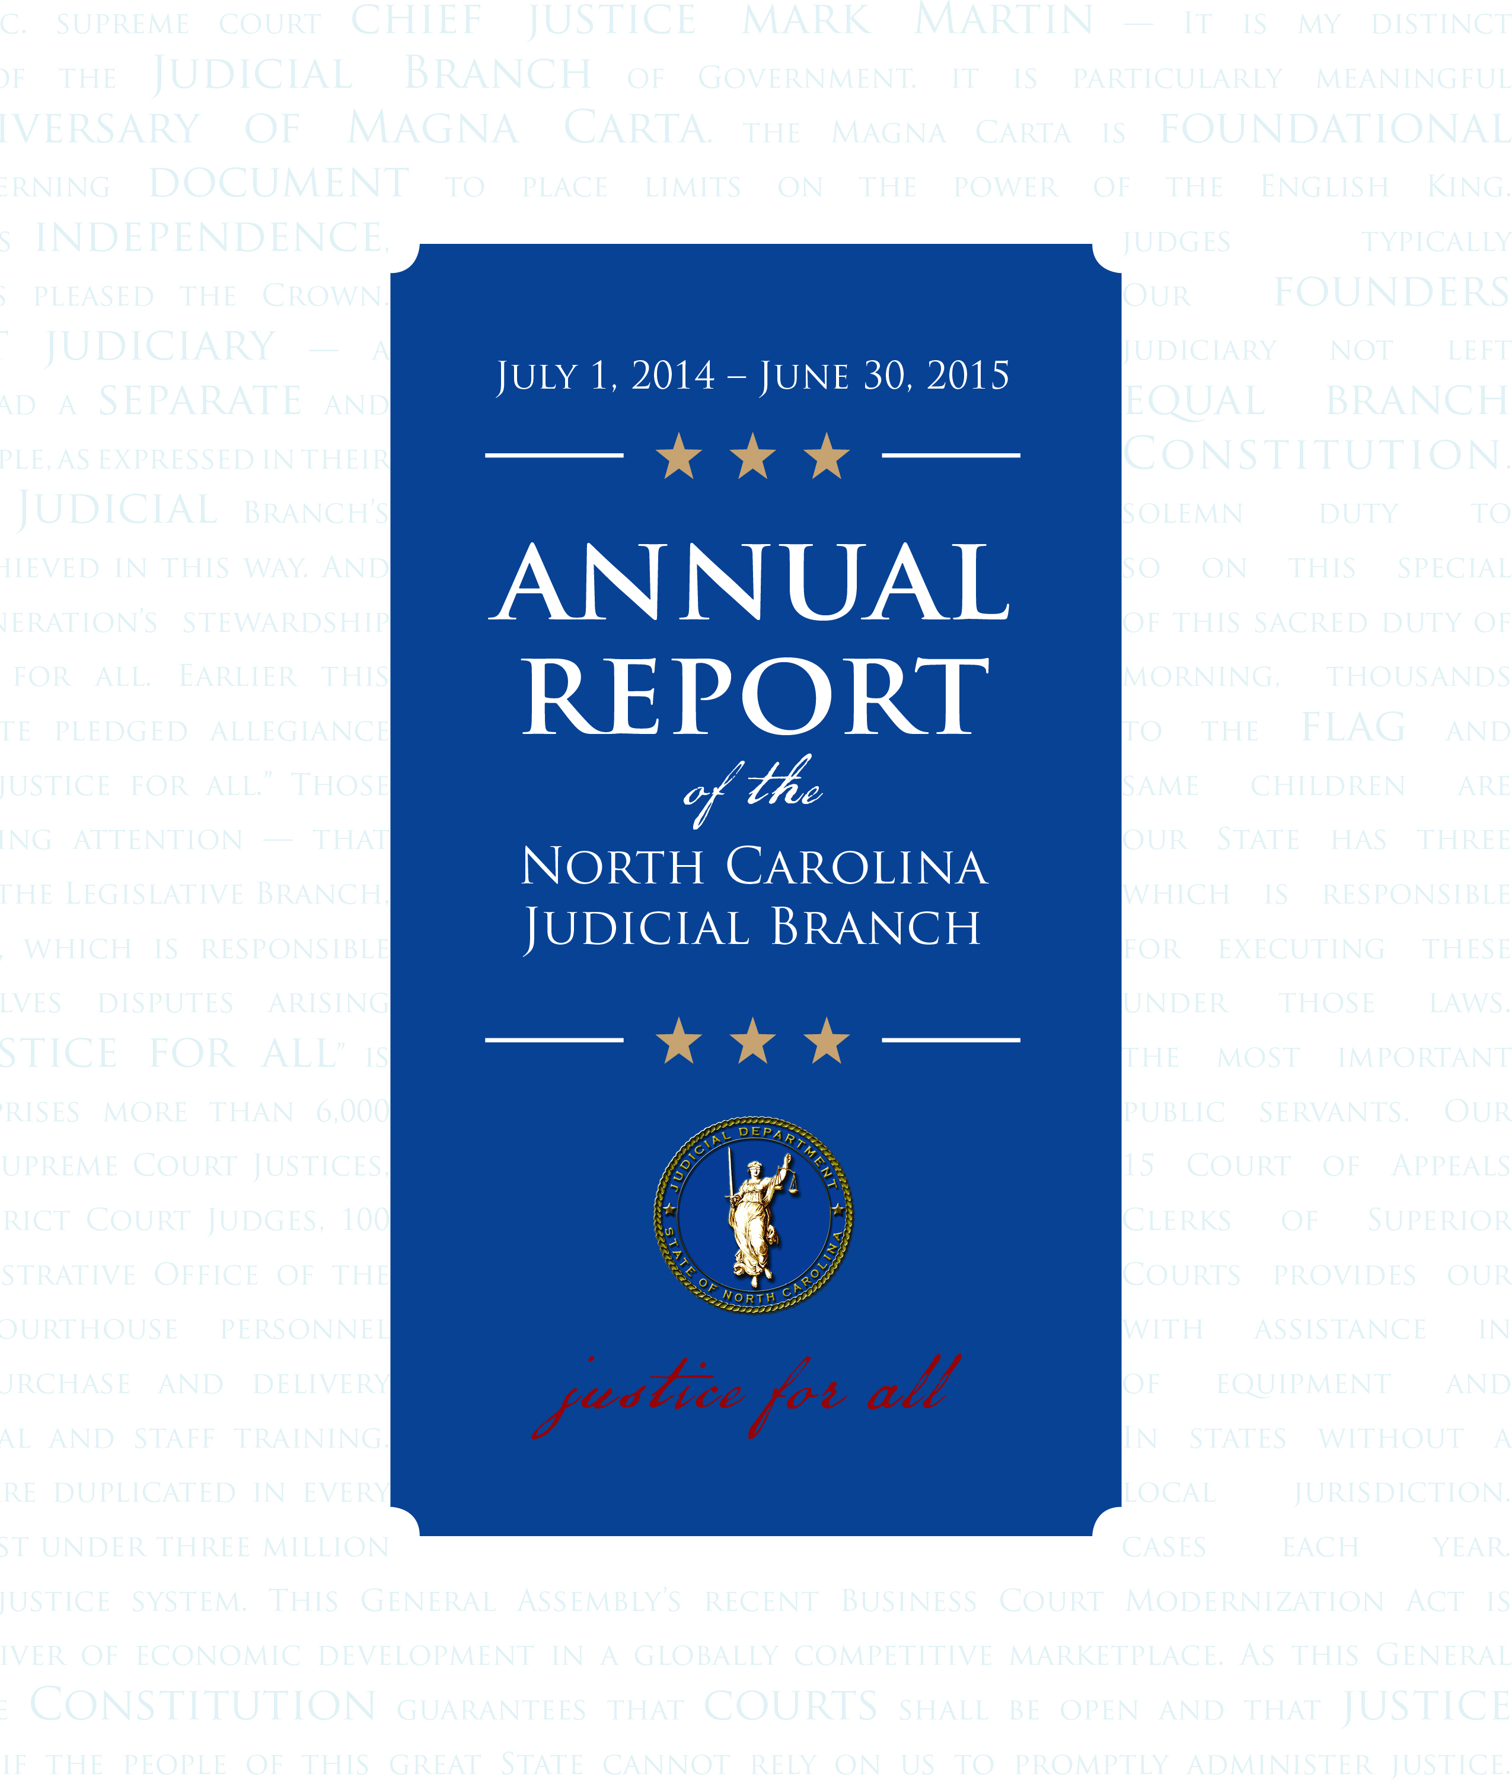
Caseloads
The district courts in this district, last year, disposed of
  Xxxxxx civil cases
  Xxxx domestic relations cases
  Xxxx criminal cases
  Xxxx motor vehicle cases
  Xxxx juvenile cases
Notes:
This slide would need to be made specific for a district, but the numbers should be easily obtained from the AOC website. This slide uses dispositions, but there are many other measures that could be used to supplement this slide—filings, average age of disposed cases, average age of pending cases. Each of those measures offers additional measures of the work of the district court. Old pending cases suggests a bottleneck in dispositions. A disposition rate that is not keeping up with fillings suggests that the courts could fall behind. No single statistic tells the whole story but this one is a useful snapshot if time is limited. For a quick introduction into the measures that are most useful, the National Center for State Courts has a very good website that can help: http://www.courtools.org/Trial-Court-Performance-Measures.aspx

Slide 12
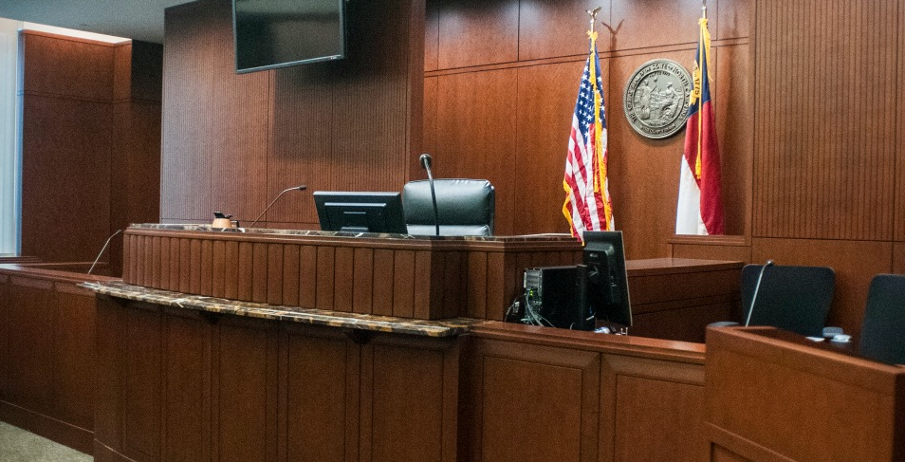
What Kind of Cases Does the
District Court Hear?
Domestic relations cases
  Divorce
  Child support
  Alimony
  Equitable distribution
  Domestic violence
Notes:
This set of slides provides an opportunity to talk about the kinds of cases that the district courts hear. There are many ways to talk about this material. Specific examples are a useful way. If there is time, actually painting a scenario and asking the audience what they would do is very effective. Keeping facts simple helps, but using specific examples is almost always more a good way to illustrate the kinds of cases heard in the district court. This is also a good place to note that the district court almost always has to hear these cases with out a jury, and how that impacts the work of the judge, who has to also run for office. There is no “cover” provided by the jury for the district court in most cases.

Slide 13
What Kind of Cases Does the
District Court Hear?
Juvenile matters
  Delinquency
  Undisciplined
  Abuse
  Neglect Dependency
Mental Illness and substance abuse voluntary and involuntary commitments
Appeals from small claims cases
Notes:
Same as previous slide

Slide 14
What Kind of Cases Does the
District Court Hear?
Criminal cases
  Misdemeanors, both traffic and non-traffic
    DWI
    Representative crimes are assault, trespass, larceny, xxx
  Preliminary matters in felony cases
  Some judges also hear guilty pleas in
  Class H and I felonies
Notes:
Same as previous slide

Slide 15
Challenges facing the District Court
XXX
XXX
XXX
XXX
Notes:
Each speaker should insert the challenges from their perspective.
There are many, among them
Funding for adequate numbers judges, support staff and advocates.
Insuring that access is provided without regard to the wealth of the parties.
Increasing numbers of self-represented litigants.
Increasing diversity in the courts, symbolized by the need for language interpreters.
Insuring that technological support is available to the courts.
Complexity of the work, especially in family court, as social movements make their way into court—gay marriage, transgender issues, surrogate parents, etc.
Maintaining the balance between political accountability and judicial independence
???

Slide 16
Justice is the end of government.
It is the end of civil society.
It ever has been and ever will be
pursued until it be obtained,
or until liberty be lost in the pursuit.
                Federalist Papers, No. 51
Notes:
This is one way to close the talk, by connecting the work of the courts with the work of the Founding Fathers, and either implicitly or explicitly, to the Magna Carta. The seeking of justice is a bedrock, foundational piece of a civil society. It is never finished, but the effort to promote a more just and fair society with the help of an effective court system will always be a major building block as we seek to create a “more perfect union”, as our Federal Constitution calls us to do.
Individual speakers will no doubt have other closing that are more appropriate to their particular talk.

Slide 17
Celebrate.NCcourts.org

